Slide 1
NON CONTACT NUMBER DETECTION FOR ATMS AND LIFTS TO PREVENT CHANCES OF COVID TRANSMISSION
FINAL REVIEW
SRAWAN PRADHAN(17BEI0058)
SHAHNAWAZ AHMAD(17BEI0017)
SHAURYA DAS(17BEI0032)
RAHUL KUMAR(17BEI0085)

Slide 2
TIMELINE
Step 2
Step 4
Framing Idea
Counting the extreme points
Done
Done
Done
Done
Done
Step 1
Step 3
Step
Problem construction
Segment extraction ,Image detection and Background
Display the output(count )

Slide 3
PREVIOUS REVIEW
Creating background and removing noises
Segmentation
Creating main method
TASK DONE FOR THIS REVIEW
Finger-tip counting

Slide 4
BACKGROUND CREATION AND NOISE REMOVAL
import cv2
import numpy as npfrom
sklearn.metrics import pairwise
background = None
accumulated_weight = 0.5
roi_top = 20
roi_bottom = 300
roi_right = 300
roi_left = 600
def calc_accum_avg(frame, accumulated_weight):
global background
if background is None:
background = frame.copy().astype("float")
return None
cv2.accumulateWeighted(frame, background, accumulated_weight)

Slide 5
SEGMENTATION
def segment(frame, threshold=25):
global background
diff = cv2.absdiff(background.astype("uint8"), frame)
_ , thresholded = cv2.threshold(diff, threshold, 255, cv2.THRESH_BINARY)
if len(contours) == 0:
return None
else:
hand_segment = max(contours,key=cv2.contourArea)
return (thresholded, hand_segment)

Slide 6
FINGERTIP COUNTING
def count_fingers(thresholded, hand_segment
conv_hull = cv2.convexHull(hand_segment
top = tuple(conv_hull[conv_hull[:, :, 1].argmin()][0])
bottom = tuple(conv_hull[conv_hull[:, :, 1].argmax()][0])
left = tuple(conv_hull[conv_hull[:, :, 0].argmin()][0])
right = tuple(conv_hull[conv_hull[:, :, 0].argmax()][0])
cX = (left[0] + right[0]) // 2 cY = (top[1] + bottom[1]) // 2
distance = pairwise.euclidean_distances([(cX, cY)], Y=[left, right, top, bottom])[0]
max_distance = distance.max()
radius = int(0.8 * max_distance)
circumference = (2 * np.pi * radius)
circular_roi = np.zeros(thresholded.shape[:2], dtype="uint8")
cv2.circle(circular_roi, (cX, cY), radius, 255, 10)
circular_roi = cv2.bitwise_and(thresholded, thresholded, mask=circular_roi)
image, contours, hierarchy = cv2.findContours(circular_roi.copy(), cv2.RETR_EXTERNAL, cv2.CHAIN_APPROX_NONE)
count = 0
for cnt in contours
(x, y, w, h) = cv2.boundingRect(cnt
out_of_wrist = ((cY + (cY * 0.25)) > (y + h)
limit_points = ((circumference * 0.25) > cnt.shape[0])
count += 1
return countcam = cv2.VideoCapture(0)

Slide 7
MAIN METHOD
num_frames = 0
while True:
ret, frame = cam.read()
frame = cv2.flip(frame, 1)
frame_copy = frame.copy()
roi = frame[roi_top:roi_bottom, roi_right:roi_left]
gray = cv2.cvtColor(roi, cv2.COLOR_BGR2GRAY)
gray = cv2.GaussianBlur(gray, (7, 7), 0)
if num_frames < 60:
calc_accum_avg(gray, accumulated_weight)
if num_frames <= 59:
cv2.putText(frame_copy, "WAIT! GETTING BACKGROUND AVG.",
(200, 400), cv2.FONT_HERSHEY_SIMPLEX, 1, (0,0,255), 2)
cv2.imshow("Finger Count",frame_copy)

Slide 8
MAIN METHOD
else:
hand = segment(gray)
if hand is not None:
thresholded, hand_segment = hand
cv2.drawContours(frame_copy, [hand_segment + (roi_right, roi_top)], -1, (255, 0, 0),1)
fingers = count_fingers(thresholded, hand_segment)
cv2.putText(frame_copy, str(fingers), (70, 45), cv2.FONT_HERSHEY_SIMPLEX, 1, (0,0,255), 2)
cv2.imshow("Thesholded", thresholded)
cv2.rectangle(frame_copy, (roi_left, roi_top), (roi_right, roi_bottom), (0,0,255), 5)
num_frames += 1
cv2.imshow("Finger Count", frame_copy)
k = cv2.waitKey(1) & 0xFF
if k == 27:
break
cam.release()
cv2.destroyAllWindows()

Slide 9
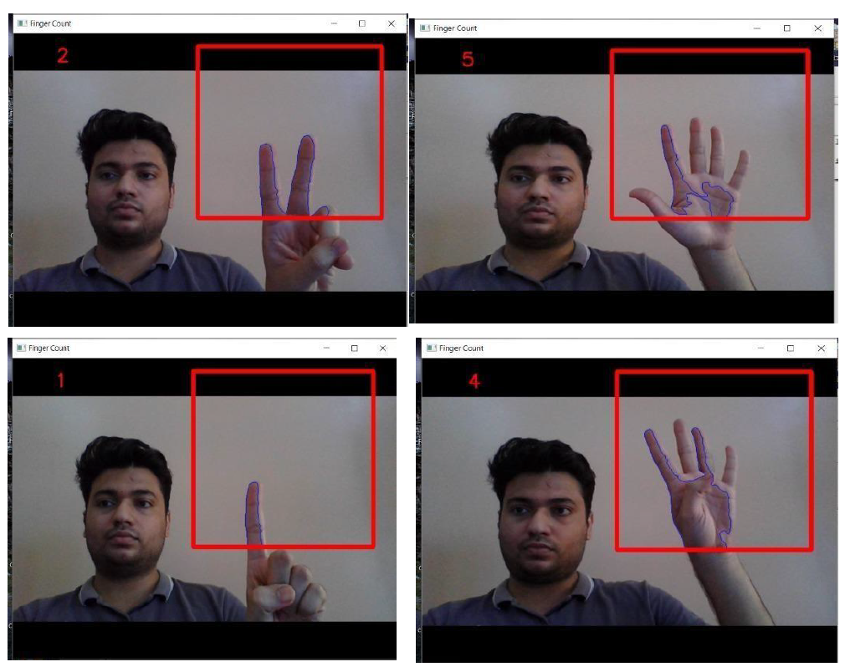
RESULT AND SCREENSHOTS
The above code was compiled and in the result we could see the counting mechanism as shown in the screenshot
https://drive.google.com/file/d/1s-LOSTDc1Z7luub1hdRZHFNLAta4KS5d/view?usp=sharing

Slide 10
THANK YOU

